Slide 1

Notes:
FAST’20

Slide 2
Outline
Introduction
Background
Overall observations
Factors impacting reliability
Correlations between failures
Lessons learned
Takeaways

Slide 3
Introduction
SSD reliability in NetApp
SSDs, not HDDs
Enterprise storage systems, not cloud data centers
High-end drives with RAID
Important characteristics of failures
Introduced in Factors
Provide observations, findings, lessons learned

Slide 4
Background
System
WAFL file system: software RAID
Data ONTAP operating system
Data
2017.1 – 2019.5
System and device parameters
Failure/replacement, reason

Slide 5
Background
SSDs
1.4 millions drives
3 manufacturers
18 different models
12 different capacities: 200GB – 15.3TB
4 different flash technologies: SLC, cMLC, eMLC, 3D-TLC
Usage, lithography, firmware
Health metrics
Number of bad blocks, percentage of spare blocks consumed
Annual Replacement Rate (ARR)
Number of device failures / number of device years

Slide 6
Overall observations
Average ARR: 0.22%
Vary widely (0.07% - 1.2%)
Significantly lower than that of data centers
The percentage of consumed spare blocks is on average less than 15%.
For vast majority of drives, early death to wear-out after prematurely reaching the PE cycle limit is unlikely.

Slide 7
Overall observations
Reasons for replacements
Category A (most severe)
SCSI error (32.78%)
Unresponsive drive (0.60%)
Category B
Lost writes
Category C
Aborted commands
Command timeouts
Category D (most benign) (34.44%)
Predictive failures
Finding 1: One third of replacements are associated with the most severe reason type, i.e. SCSI error. One third of drive replacements are merely preventative based on predictions.
Notes:
SCSI - Small Computer System Interface

Slide 8
Factors impacting reliability
Reliability metric: Annual Replacement Rate
9 factors
Usually broken down by replacement category

Slide 9
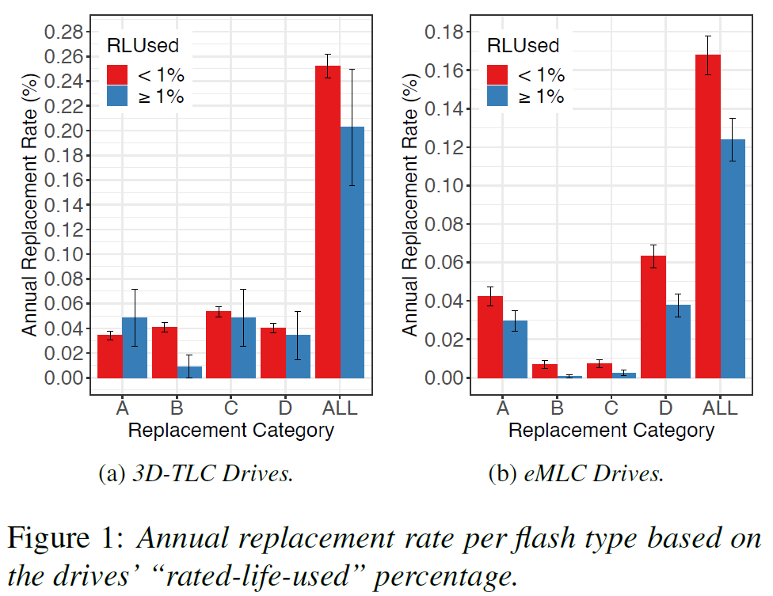
Factors – usage and age
Usage: Rated life used
(used PE cycles / PE cycle limit) %
Observations
Infant mortality
Heavily used drives are more likely to be replaced due to predictive failures

Slide 10
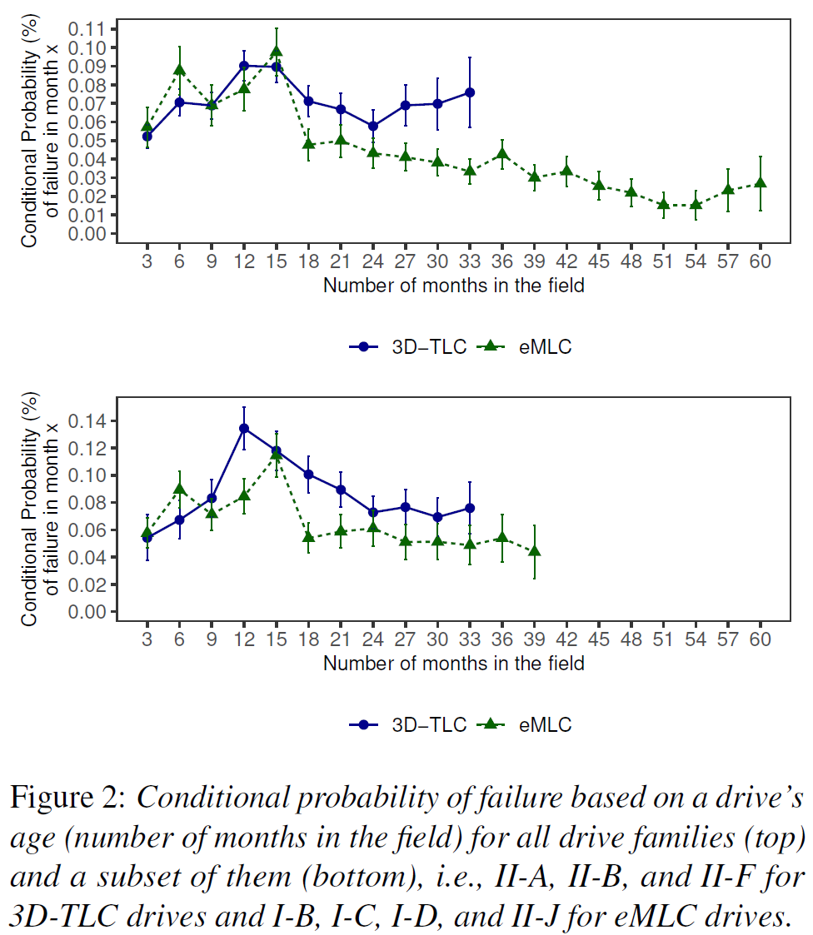
Factors – usage and age
Age
Observations
An unexpectedly long period of infant mortality: 1-2 years
Differs from “bathtub” model
Finding 2: A very drawn-out period of infant mortality (more than a year) with 2-3X larger failure rates.

Slide 11
Factors – technology
Technology (flash type): SLC, cMLC, eMLC, 3D-TLC
Observations
Higher ARRs for 3D-TLC devices; 3D-TLC drives have consumed 10-15X more of their spare blocks
Finding 3: The highest replacement rates are associated with 3D-TLC SSDs. However, no single flash type has noticeably higher replacement rates than the others, indicating that other factors can have a bigger impact on reliability.

Slide 12
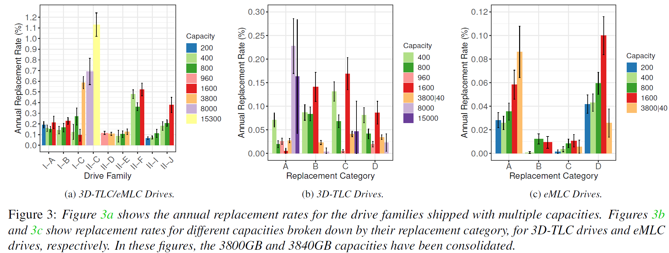
Factors – capacity
Observations
For larger capacities, there is a clear trend for increasing ARRs.
For the largest capacity drives, the rate of predictive failures is lower, and the rate of severe failures is higher.

Slide 13
Factors – capacity
Observations
For larger capacities, there is a clear trend for increasing ARRs.
For the largest capacity drives, the rate of predictive failures is lower, and the rate of severe failures is higher.
Finding 4: Drives with very large capacities not only see a higher replacement rate overall, but also see more severe failures and fewer of the (more benign) predictive failures.

Slide 14
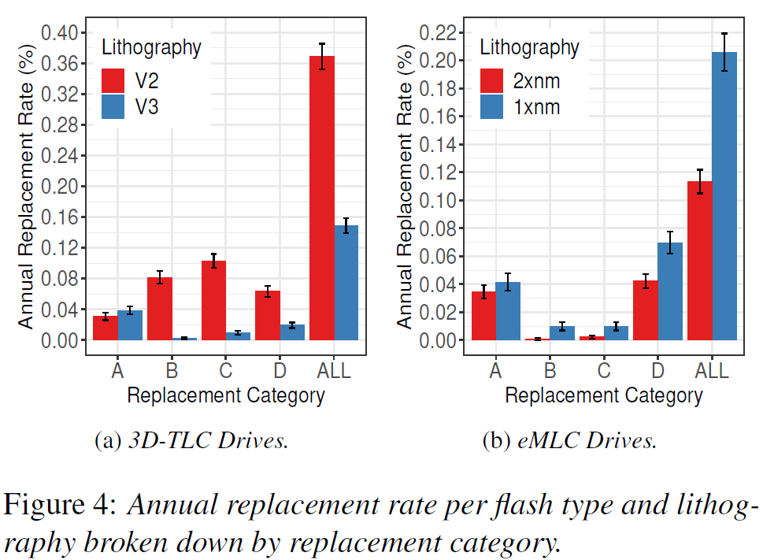
Factors – lithography
Lithography
Models with smaller lithography report higher RBERs
Observations
eMLC drives: higher ARRs for the higher density 1xnm drives
3D-TLC drives: higher ARRs for the lower density V2 drives
Finding 5: Higher density drives do not always see higher replacement rates.
However, no explanation…

Slide 15
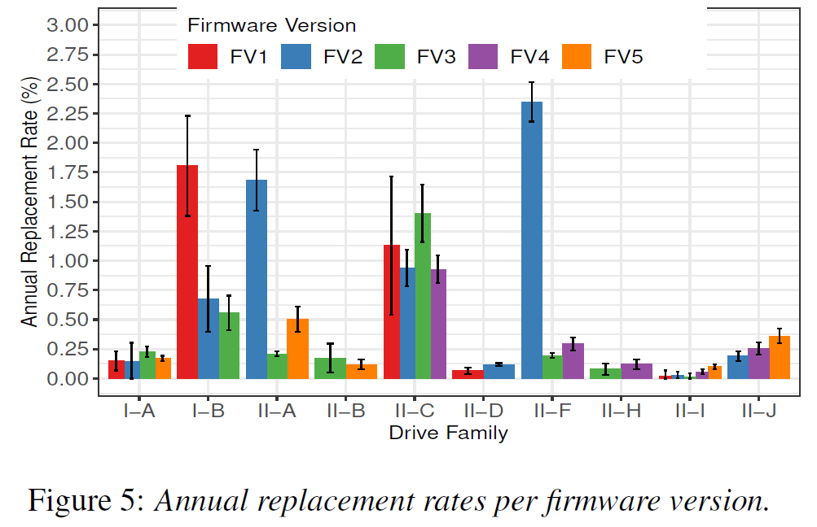
Factors – firmware
Firmware (within the same family)
Observations
Tremendous impact: an order of magnitude higher ARR for the earliest versions
Not due to infant mortality
Explanations: bug fixes and improvements
Finding 6: Earlier firmware versions can be correlated with significantly higher replacement rates, emphasizing the importance of firmware updates.

Slide 16
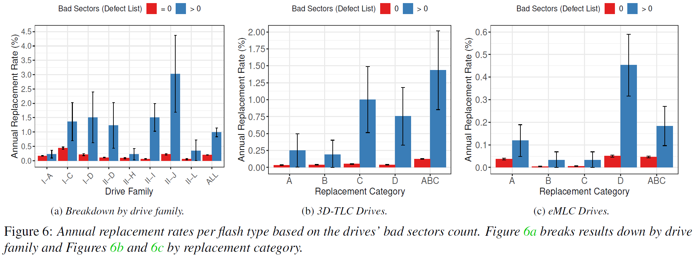
Factors – number of bad blocks
Metrics
Length of g-list (an entry for every unrecoverable block)
Number of consumed spare blocks
Notes:
The g-list is maintained by the operating system

Slide 17
Factors – number of bad blocks
Metrics
Length of g-list (an entry for every unrecoverable block)
Number of consumed spare blocks
Finding 7: SSDs with a non-empty g-list have a higher ARR, not only due to predictive failures, but also other reasons.
Finding 8: SSDs that make greater use of their spare blocks are more likely to be replaced in the future.
Notes:
The g-list is maintained by the operating system

Slide 18
Factors – others
Factors
System role: storage, cache
Device role: data, parity
The amount of Over-provisioning
No clear correlation.

Slide 19
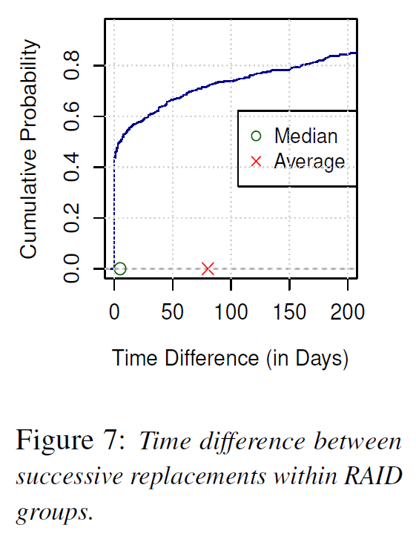
Correlations between failures
Temporal correlations
Observations
The probability that a RAID group experience a drive replacement: 0.0504%
Another replacement within a week: 9.39%
The second replacement follows within a short interval
Explanations
RAID reconstruction imposes additional loads to the other drives
Shared environmental issues

Slide 20
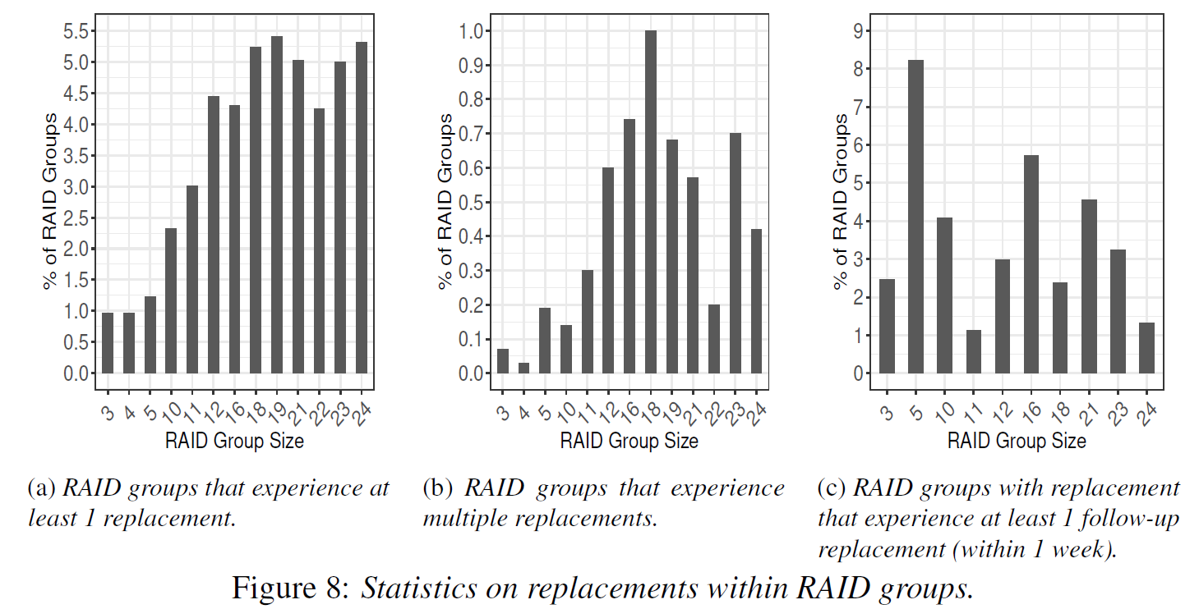
Correlations between failures
RAID group size
Observations
Larger RAID groups have higher ARRs
For the groups with at least 2 replacements, the correlation is not clear
Notes:
The g-list is maintained by the operating system

Slide 21
Correlations between failures
RAID group size
Observations
Larger RAID groups have higher ARRs
For the groups with at least 2 replacements, the correlation is not clear
Finding 9: Large RAID groups have a larger number of drive replacements. The rate of multiple failures is not correlated with RAID group size, because a follow-up failure is not correlated with RAID group size.
Notes:
The g-list is maintained by the operating system

Slide 22
Lessons learned (1)
The importance of firmware updates.
Larger RAID group size create more potential for failures, however, not multiple failures.
Single parity RAID configurations might be susceptible to data loss because of temporal correlation of failures.
Drives with very large capacities see more severe failures.
Bad prediction for large capacities.
A move towards QLC’s PE cycle limits poses no risks, although they are significantly lower than current TLC’s.

Slide 23
Lessons learned (2)
The failures due to infant mortality are likely to be a big threat.
In contrast to the “bathtub”, the authors observe no sign of failure rate increases at the end of life and also a very drawn-out period of infant mortality.
An extended, more intense burn-in period before deployment is recommended, since there is room to sacrifice some PE cycles in the burn-in process.
Flash type plays a smaller role than lithography or capacity.

Slide 24
Takeaways
SSD reliability vs. DRAM reliability
A thorough analysis about SSD. A good start.
Lessons learned are useful.

